Slide 1
Backend Overview: Team 1
Lucas Bastos & Leena DeLucci

Slide 2
Background
Tools: Django, PostgreSQL, Python
Design: Canva, HTML, CSS
Collaboration: Zoom, Teams
Models: Level 0 and Level 1 DFD diagrams

Slide 3
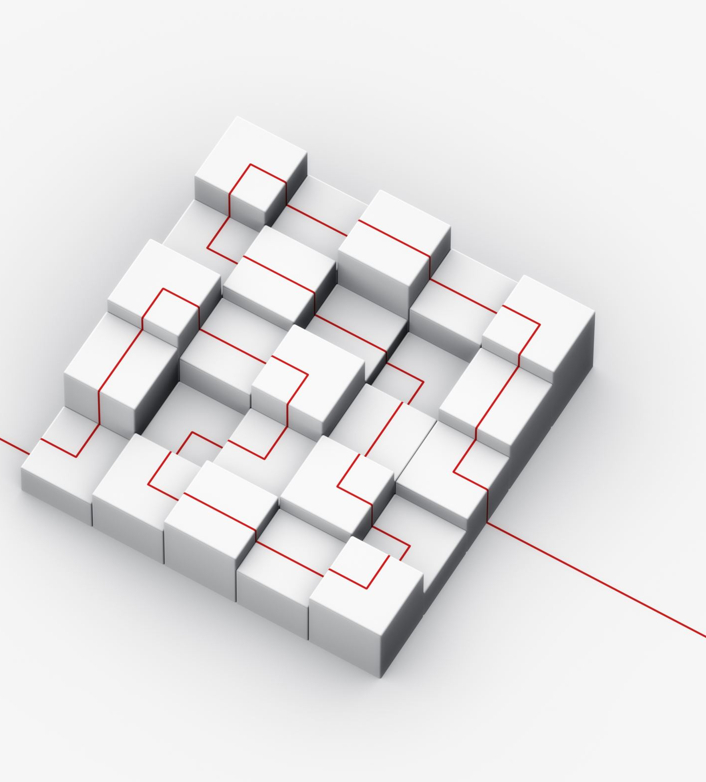
Setting Up the Django Project
• Create new Django project
• Configure PostgreSQL as database

Slide 4
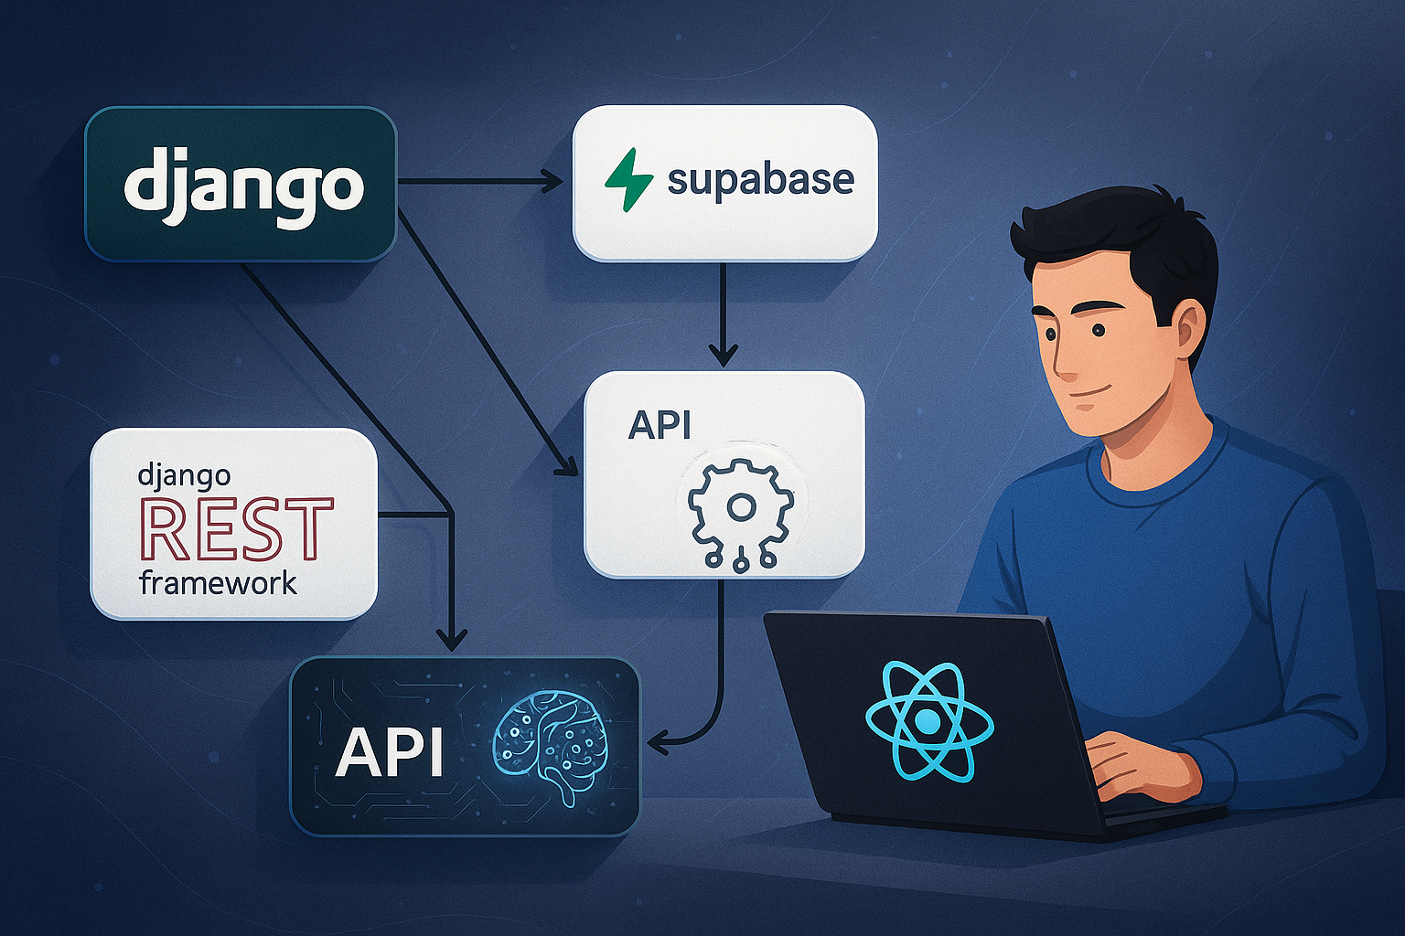
Backend Design

Slide 5
API Development
• Endpoints for inventory, users, and orders
• Built using Django REST Framework
• Secure authentication and authorization

Slide 6
Data Management
• Models: Products, Orders, Users, Sales
• Create and apply migrations

Slide 7
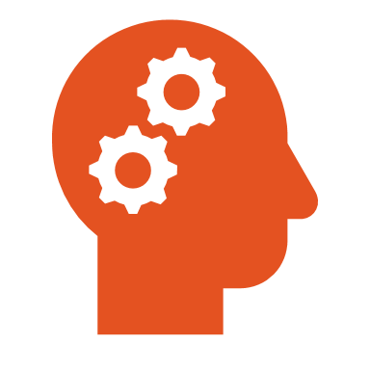
AI Integration
• Predict restocking needs using sales data
• Coordinated with Leena for AI implementation

Slide 8
Real-Time Features
• Real-time stock updates and notifications
• Implemented using Django Channels

Slide 9
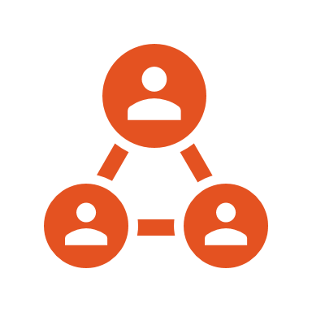
Frontend Development
• Ethan (HTML/CSS): Interactive prototype
• Gracy (Canva): Workflow modeling
• Components: Login, Dashboard, Stock, Orders, Reports

Slide 10
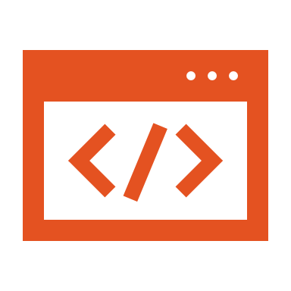
Testing and Debugging
• Unit and integration testing with Python
• Identify and resolve issues across backend/frontend

Slide 11
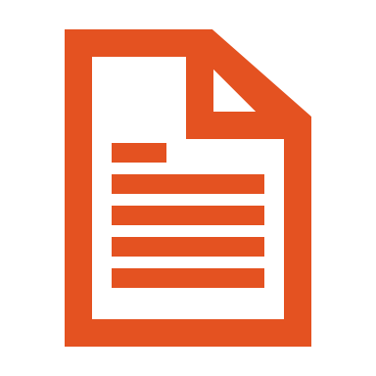
Documentation
• API documentation using Swagger/Postman
• Clear in-code documentation for developers

Slide 12
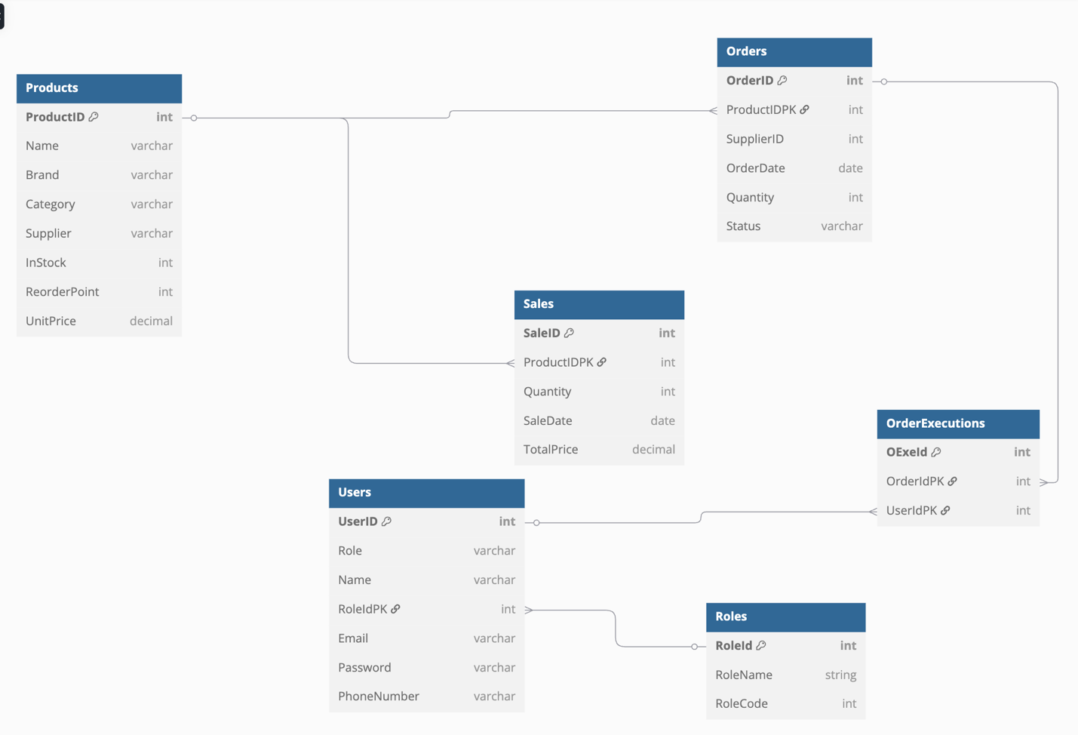
Database Schema Overview
Tables: Products, Orders, Sales, OrderExecutions, Users, Roles

Slide 13
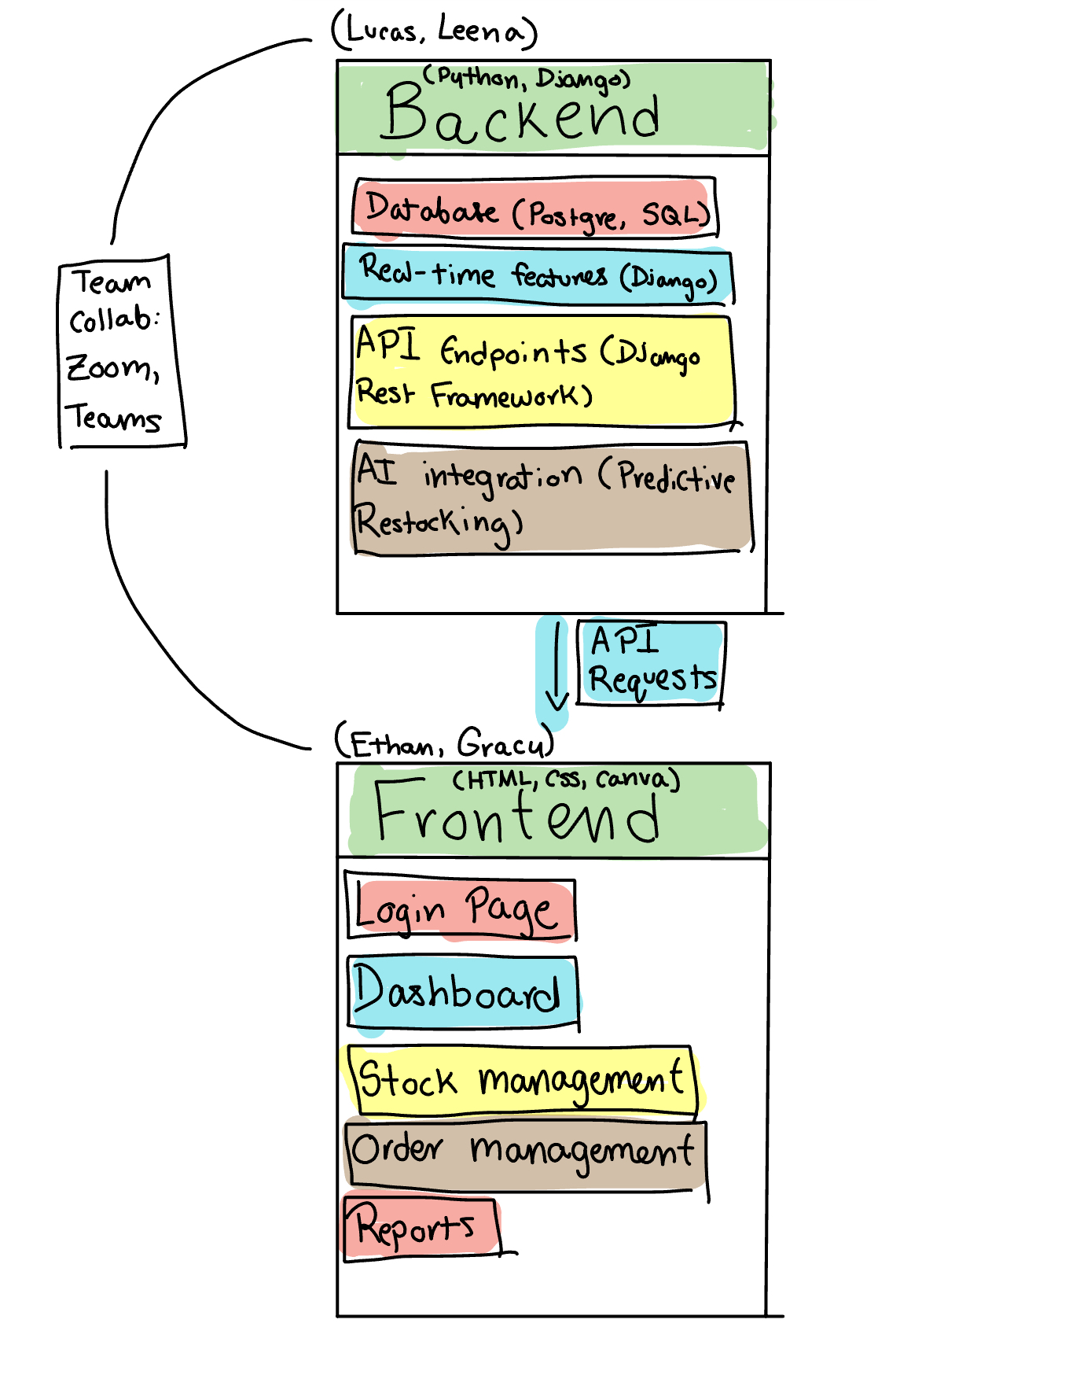
Diagram of Backend-Frontend Communications

Slide 14
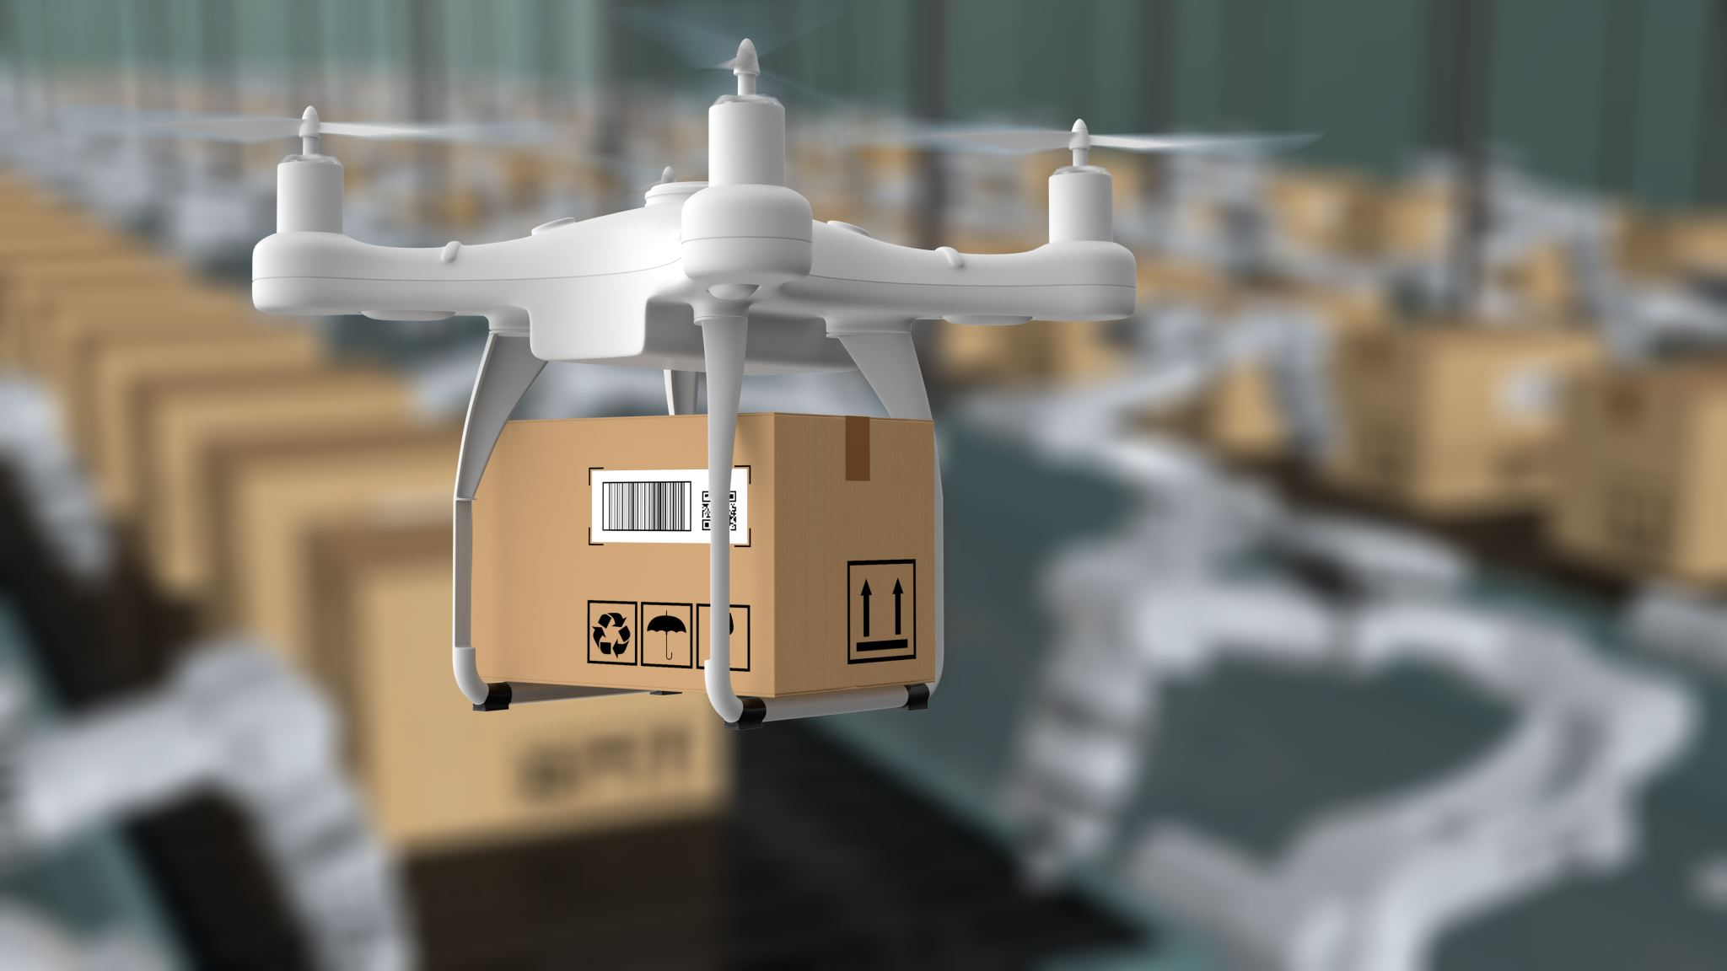
Conclusion
Our backend system supports automation, AI forecasting, and real-time reporting—all for smarter inventory management.
Thank you.

